Slide 1
G
R
E
E
N
G
A
I
T
Notes:
Superteam Deck Notes: Put your startup name and logo with a 1-line subtitle.
This subtitle should be a game changer - it focuses on outcomes and the secret sauce.
(eg. “Decentraland - a virtual world owned by its users”)

Slide 2

G
E
N
R
E
G
I
A
T
Move to earn, live to sustain
powered by motion, secured by blockchain
Notes:
Superteam Deck Notes: Put your startup name and logo with a 1-line subtitle.
This subtitle should be a game changer - it focuses on outcomes and the secret sauce.
(eg. “Decentraland - a virtual world owned by its users”)

Slide 3







Table of contents
G
R
E
E
N
1
6
Ending Notes
The Problem
G
I
A
T
2
5
The Solution
Live Demo
3
4
Technical Architecture
Technical & Design Decisions
GreenGait
Notes:
Superteam Deck Notes: Put your startup name and logo with a 1-line subtitle.
This subtitle should be a game changer - it focuses on outcomes and the secret sauce.
(eg. “Decentraland - a virtual world owned by its users”)

Slide 4

The Problem
❌ 76% of people miss daily activity goals
❌ ESG apps fail to motivate real action
❌ Energey dependence
🙋 We wanted to fix this from the ground up
% Inactive Adults
35%
30%
26%
2010
2020
2030
GreenGait
01
Notes:
Superteam Deck Notes: Put your startup name and logo with a 1-line subtitle.
This subtitle should be a game changer - it focuses on outcomes and the secret sauce.
(eg. “Decentraland - a virtual world owned by its users”)

Slide 5




The Solution
✅ Press a wearable button = 1 step
🔐 HMAC (Hash-based Message Authentication Code) -signed data + TLS (Transport Layer Security) transmission
⛓️ Solana smart contract verifies and logs
🪙 GG token minted after every X steps
GreenGait
02
Notes:
Superteam Deck Notes: Put your startup name and logo with a 1-line subtitle.
This subtitle should be a game changer - it focuses on outcomes and the secret sauce.
(eg. “Decentraland - a virtual world owned by its users”)

Slide 6

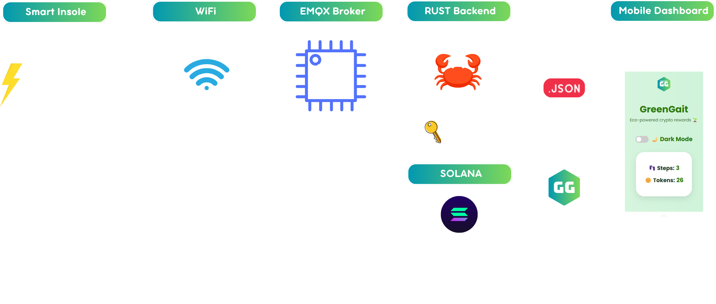
Technical Architecture
GreenGait
03
Notes:
Superteam Deck Notes: Put your startup name and logo with a 1-line subtitle.
This subtitle should be a game changer - it focuses on outcomes and the secret sauce.
(eg. “Decentraland - a virtual world owned by its users”)

Slide 7

Technical & Design Decisions
Designed for Secured, Trusted & Scaled Infrastructure:
🔐 MQTT (Message Queuing Telemetry Transport) + mutual TLS = authenticated devices only
🔄 HMAC + Nonce + Timestamp = no replay
📦 PDA = one unique log per user per day
⚙️ Prioritized: full secure flow → delayed UX/marketplace
⛓️ Used Solana + Anchor for scalability and transparency
GreenGait
04
Notes:
Superteam Deck Notes: Put your startup name and logo with a 1-line subtitle.
This subtitle should be a game changer - it focuses on outcomes and the secret sauce.
(eg. “Decentraland - a virtual world owned by its users”)

Slide 8

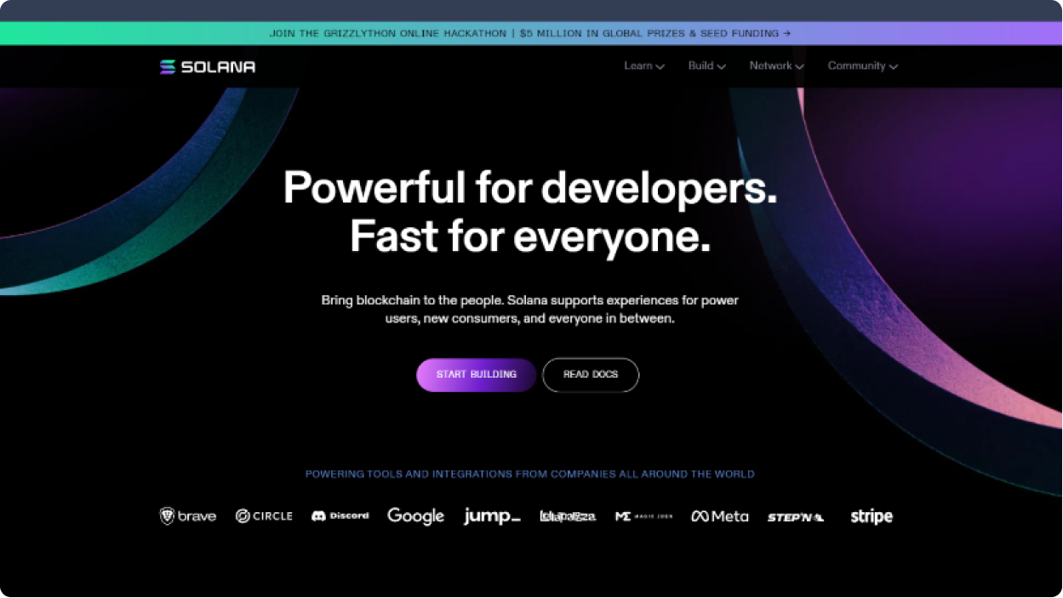
Live Demo
GreenGait
05
Notes:
Superteam Deck Notes: Put your startup name and logo with a 1-line subtitle.
This subtitle should be a game changer - it focuses on outcomes and the secret sauce.
(eg. “Decentraland - a virtual world owned by its users”)

Slide 9
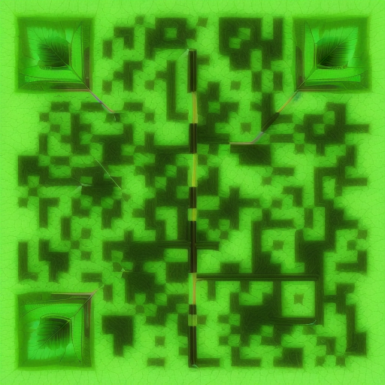

Ending Notes
G
R
E
E
N
Built at Renaissance – Ready to Scale:
🛠️ Full system built: IoT → Solana → UI
🌱 GG token = gamified ESG action
💬 Excited to expand: harvesting system integration, wearables, ESG dashboards, marketplace, GPS integration
Repository
G
I
T
A
Move to earn, live to sustain
powered by motion, secured by blockchain
GreenGait
06
Notes:
Superteam Deck Notes: Put your startup name and logo with a 1-line subtitle.
This subtitle should be a game changer - it focuses on outcomes and the secret sauce.
(eg. “Decentraland - a virtual world owned by its users”)

Slide 10
G
E
N
R
E
G
I
A
T
Notes:
Superteam Deck Notes: Put your startup name and logo with a 1-line subtitle.
This subtitle should be a game changer - it focuses on outcomes and the secret sauce.
(eg. “Decentraland - a virtual world owned by its users”)

